Slide 1
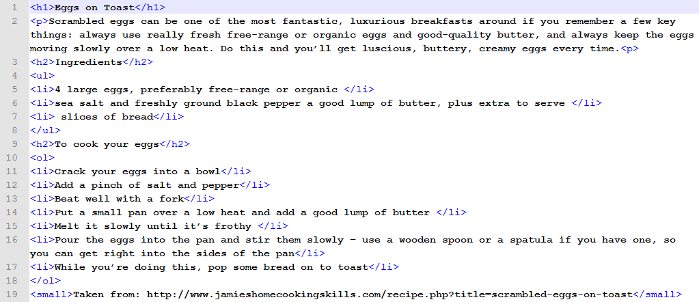
In Notepad++, Mark up the eggs.html file to look like this.
Save it in your own folder as eggs.html and then choose Run->View in IE to see the finished webpage in Internet Explorer

